Slide 1
Lecture 2

Slide 2
Contents
Tokens in Java
Comments in Java
Variables in Java
Datatypes in Java
Operators and expressions in Java
Decision making and branching

Slide 3
Tokens in Java
Smallest individual units in a program are known as tokens.
Java program is a collection of tokens, comments and white spaces
Reserved Keywords-must be written in lower case
Identifiers-programmer designed tokens.
a) alphabets,digits,underscore and dollor sign
b)not begin with digit
c)upper and lower case letters
d)any length
3. Literals
4. Operators
5.Separators-parathesis,braces,semicolon,comma,dot

Slide 4
Keywords in Java
abstract
assert
boolean
break
byte
case
catch
char
class
const
continue
default
do
double
else
enum
extends
false
final
finally
float
for
goto
if
implements
import
instanceof
int
interface
long
native
new
null
package
private
protected
public
return
short
static
strictfp
super
switch
synchronized
this
throw
throws
transient
true
try
void
volatile
while

Slide 5
Comments in Java
Comments in a program are called inline documentation
They should be included to explain the purpose of the program and describe processing steps
They do not affect how a program works
Java comments can take two forms:
// this comment runs to the end of the line
/* this comment runs to the terminating symbol, even across line breaks */

Slide 6
Escape sequences in Java
What if we wanted to print the quote character?
The following line would confuse the compiler because it would interpret the second quote as the end of the string
System.out.println ("I said "Hello" to you.");
An escape sequence is a series of characters that represents a special character
An escape sequence begins with a backslash character (\)
System.out.println ("I said \"Hello\" to you.");

Slide 7
Escape sequences in Java
Escape Sequence
\b
\t
\n
\r
\"
\'
\\
Meaning
backspace
tab
newline
carriage return
double quote
single quote
backslash

Slide 8
Variables in Java
Variables are containers for storing data values.
In Java, there are different types of variables, for example:
String - stores text, such as "Hello". String values are surrounded by double quotes
int - stores integers (whole numbers), without decimals, such as 123 or -123
float - stores floating point numbers, with decimals, such as 19.99 or -19.99
char - stores single characters, such as 'a' or 'B'. Char values are surrounded by single quotes
boolean - stores values with two states: true or false

Slide 9
To create a variable, you must specify the type and assign it a value:
type variable = value;
e.g. String name = "John"; System.out.println(name);

Slide 10
Scope of variables
Instance variables
Class variables
Local variables

Slide 11
Scope of variables
Instance variables:
They are created when objects are instantiated , therefore they are associated with the objects.
Class Variables:
They are global to a class and belong to the entire set of objects that class creates. Only one memory location is created for each class variable.
Local Variables:
They are declared and used inside methods, not available outside the method definition.

Slide 12
Data types
data types
primitive non primitive
Numeric non numeric classes interface arrays
int float/double char(unicode 16 bit)) boolean
byte (8 bit -128 to 127)
short(16 bit -32768 to 32767)
int( 32 bit )
long(64 bit)

Slide 13
JAVA datatypes
Data Type | Size | Description
byte | 1 byte | Stores whole numbers from -128 to 127
short | 2 bytes | Stores whole numbers from -32,768 to 32,767
int | 4 bytes | Stores whole numbers from -2,147,483,648 to 2,147,483,647
long | 8 bytes | Stores whole numbers from -9,223,372,036,854,775,808 to 9,223,372,036,854,775,807
float | 4 bytes | Stores fractional numbers. Sufficient for storing 6 to 7 decimal digits
double | 8 bytes | Stores fractional numbers. Sufficient for storing 15 decimal digits
boolean | 1 bit | Stores true or false values
char | 2 bytes | Stores a single character/letter or ASCII values

Slide 14
Operators
Arithmetic(+,-,*,/,%,++,+=,-=,*=,/=,%=,--)
Bitwise operators(~,&,|,^,>>,<<)
Logical Operators(&&,||,!)
Relational operators(==,!=,>,<,>=,<=)
Ternary Operator
expression1?expression2:expression3
Ex:i=10;
K=i<0?-i:i;

Slide 15
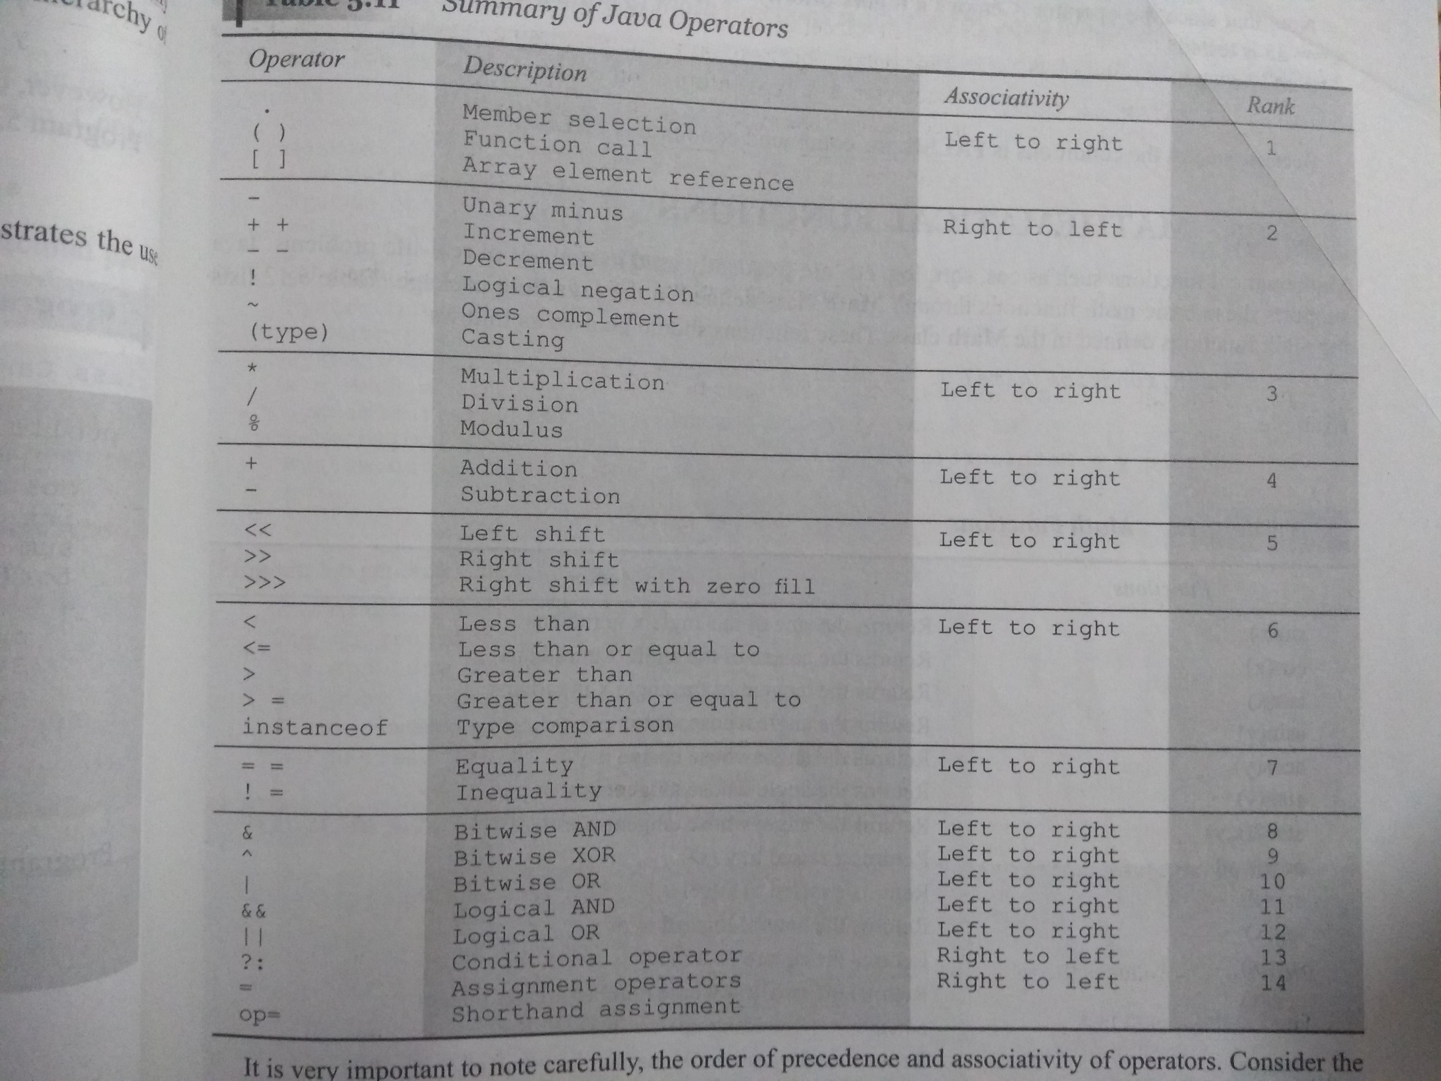

Slide 16
Accepting input through Scanner class
Scanner s1=new Scanner(System.in);
Since Scanner class is defined in util package, so import util package
Scanner class methods:
String ---objectname.nextLine();
char---objectname.next();
int---objectname.nextInt();
Float---objectname.nextFloat();
double---objectname.nextDouble();

Slide 17
Control structures

Slide 18
Control structures
The if Statement
Use the if statement to specify a block of Java code to be executed if a condition is true.
Syntax:
if (condition) { // block of code to be executed if the condition is true }

Slide 19
Control structures
The if…else Statement:
Use the else statement to specify a block of code to be executed if the condition is false.
Syntax:
if (condition)
{ // block of code to be executed if the condition is true }
else
{ // block of code to be executed if the condition is false }

Slide 20
Control structures
The switch Statement:
Use the switch statement to select one of many code blocks to be executed.
Syntax:
switch(expression) { case x: // code block break; case y: // code block break; default: // code block }

Slide 21
Control structures
Loops: while
The while loop loops through a block of code as long as a specified condition is true:
Syntax:
while (condition) { // code block to be executed }

Slide 22
Control structures
Loops:The Do/While Loop
The do/while loop is a variant of the while loop. This loop will execute the code block once, before checking if the condition is true, then it will repeat the loop as long as the condition is true.
Syntax:
do { // code block to be executed } while (condition);

Slide 23
Control structures
Loops: When you know exactly how many times you want to loop through a block of code, use the for loop instead of a while loop.
Syntax:
for (statement 1; statement 2; statement 3)
{ // code block to be executed }

Slide 24
Control structures
Loops: For-Each Loop
There is also a "for-each" loop, which is used exclusively to loop through elements in an array:
Syntax:
for (type variable : arrayname) { // code block to be executed }
e.g.
String[] cars = {"Volvo", "BMW", "Ford", "Mazda"}; for (String i : cars) { System.out.println(i); }

Slide 25
Control structures
break:
Break is used in switch
The break statement can also be used to jump out of a loop.
e.g.
for (int i = 0; i < 10; i++) { if (i == 4) { break; } System.out.println(i); }

Slide 26
Control structures
continue
The continue statement breaks one iteration (in the loop), if a specified condition occurs, and continues with the next iteration in the loop.
e.g.
for (int i = 0; i < 10; i++) { if (i == 4) { continue; } System.out.println(i); }

Slide 27
Arrays
Java Arrays:
Arrays are used to store multiple values in a single variable, instead of declaring separate variables for each value.
To declare an array, define the variable type with square brackets:
String[] cars;

Slide 28
Arrays
Java Arrays:
Arrays are used to store multiple values in a single variable, instead of declaring separate variables for each value.
To declare an array, define the variable type with square brackets:
String[] cars;
String[] cars = {"Volvo", "BMW", "Ford", "Mazda"};

Slide 29
Arrays
Java Arrays:
Arrays are used to store multiple values in a single variable, instead of declaring separate variables for each value.
To declare an array, define the variable type with square brackets:
String[] cars;
String[] cars = {"Volvo", "BMW", "Ford", "Mazda"};

Slide 30
Arrays
Access the Elements of an Array:
You access an array element by referring to the index number.
String[] cars = {"Volvo", "BMW", "Ford", "Mazda"}; System.out.println(cars[0]);
Change an Array Element:
To change the value of a specific element, refer to the index number:
String[] cars = {"Volvo", "BMW", "Ford", "Mazda"}; cars[0] = "Opel"; System.out.println(cars[0]);

Slide 31
Arrays
Array Length:
To find out how many elements an array has, use the length property:
String[] cars = {"Volvo", "BMW", "Ford", "Mazda"}; System.out.println(cars.length);
Loop Through an Array
You can loop through the array elements with the for loop, and use the length property to specify how many times the loop should run.
String[] cars = {"Volvo", "BMW", "Ford", "Mazda"}; for (int i = 0; i < cars.length; i++) { System.out.println(cars[i]); }

Slide 32
Arrays
Loop Through an Array with For-Each:
There is also a "for-each" loop, which is used exclusively to loop through elements in arrays:
for (type variable : arrayname) { ... }
String[] cars = {"Volvo", "BMW", "Ford", "Mazda"}; for (String i : cars) { System.out.println(i); }

Slide 33
2D-Arrays
To create a two-dimensional array, add each array within its own set of curly braces.
int[][] myNumbers = { {1, 2, 3, 4}, {5, 6, 7} };
e.g.
int[][] myNumbers = { {1, 2, 3, 4}, {5, 6, 7} }; int x = myNumbers[1][2];
System.out.println(x);

Slide 34
2D-Arrays
Variable length columns:
public class MyClass { public static void main(String[] args) { int[][] myNumbers = { {1, 2, 3, 4}, {5, 6, 7} }; for (int i = 0; i < myNumbers.length; ++i) { for(int j = 0; j < myNumbers[i].length; ++j) { System.out.println(myNumbers[i][j]); } } } }

Slide 35
Methods
A method is a block of code which only runs when it is called.
You can pass data, known as parameters, into a method.
Methods are used to perform certain actions, and they are also known as functions.
Create a Method:
A method must be declared within a class.
It is defined with the name of the method, followed by parentheses ().
public class MyClass { static void myMethod()
{ // code to be executed } }

Slide 36
Methods
Call a Method:
To call a method in Java, write the method's name followed by two parentheses () and a semicolon;
public class MyClass { static void myMethod() { System.out.println("I just got executed!"); } public static void main(String[] args) { myMethod(); } }

Slide 37
Methods
Method Parameters:
Information can be passed to functions as parameter. Parameters act as variables inside the method.
Parameters are specified after the method name, inside the parentheses. You can add as many parameters as you want, just separate them with a comma.
public class MyClass { static void myMethod(String fname) { System.out.println(fname); } public static void main(String[] args) { myMethod("Liam"); myMethod("Jenny"); myMethod("Anja"); } }

Slide 38
Methods
Return Values:
The void keyword, used in the examples above, indicates that the method should not return a value.
If you want the method to return a value, you can use a primitive data type (such as int, char, etc.) instead of void, and use the return keyword inside the method:
public class MyClass { static int myMethod(int x) { return 5 + x; } public static void main(String[] args) { System.out.println(myMethod(3)); } }

Slide 39
Methods
public class MyClass { static int myMethod(int x, int y) { return x + y; } public static void main(String[] args) { System.out.println(myMethod(5, 3)); } }

